Slide 1
IIT INTERNS COLD MAILING PROCESS

Slide 2
STEP 1:
Resume Building
My CV while applying (Jan 2021) : Link
My current resume (Dec 2021) : Link
Research Resume Template : Link

Slide 3
Step 2:
Top 10 IITs List:
IIT Madras
IIT Delhi
IIT Bombay
IIT Kanpur
IIT Kharagpur
IIT Roorkee
IIT Guwahati
IIT Hyderabad
IIT Jharkhand
IIT Indore
https://che.iitm.ac.in/core-faculty/
http://chemical.iitd.ac.in/faculties/
https://www.che.iitb.ac.in/index.php/faculty-directory
https://www.iitk.ac.in/che/faculty.html
http://www.iitkgp.ac.in/faclistbydepartment
https://ch.iitr.ac.in/departments/CH/pages/People+Faculty.html
https://www.iitg.ac.in/iitg_faculty_all
https://iith.ac.in/people/faculty/#profile
https://www.iitism.ac.in/index.php/Departments/faculties_chem
https://www.iiti.ac.in/departments (Chemical Engg NA)

Slide 4
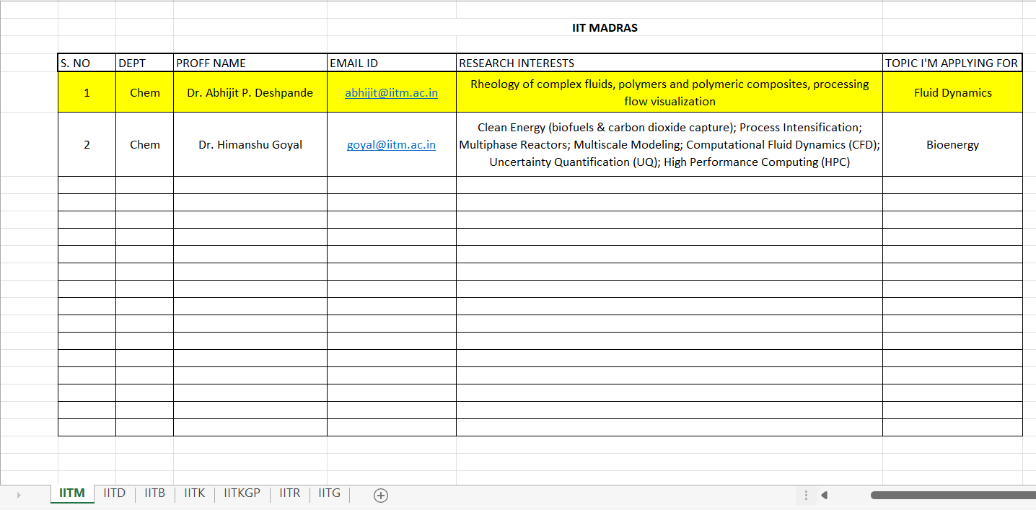
STEP 3:
Know your domain
Prepare an Excel

Slide 5
STEP 4:
Mailing
Do not mail from webmail.
Wait consistently for replies.
Do not lose hope.
Best mailing time: 8:00 – 9:00 AM

Slide 6
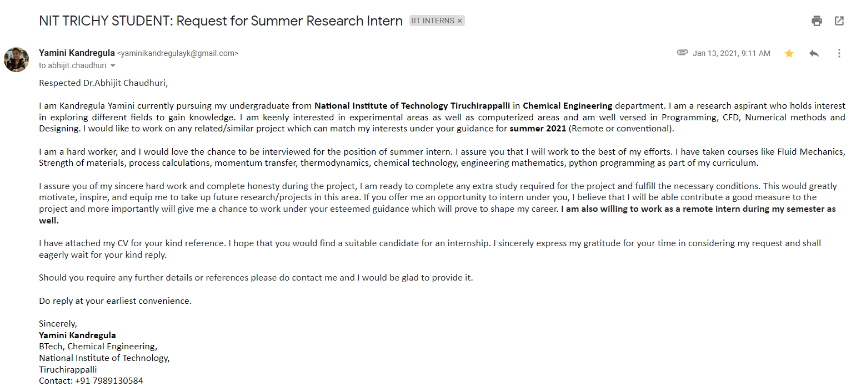

Slide 7
Comprehend your future plans
STEP 5:
Replies
The replies you get
The way you should respond

Slide 8
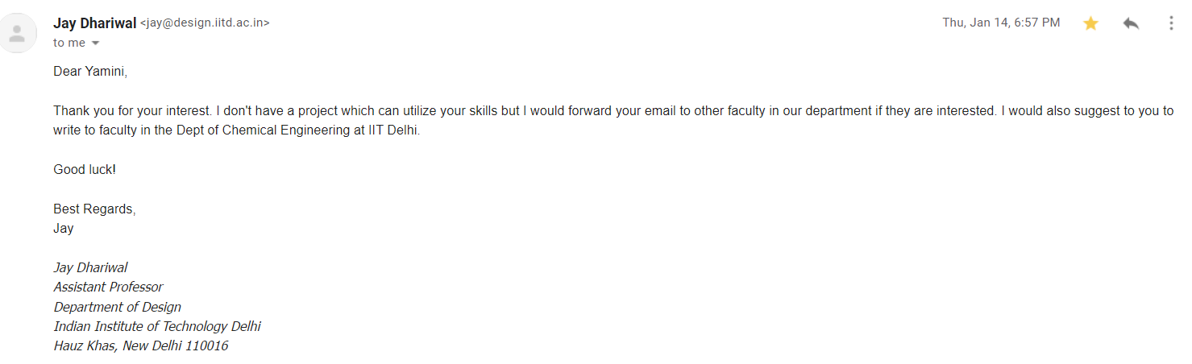
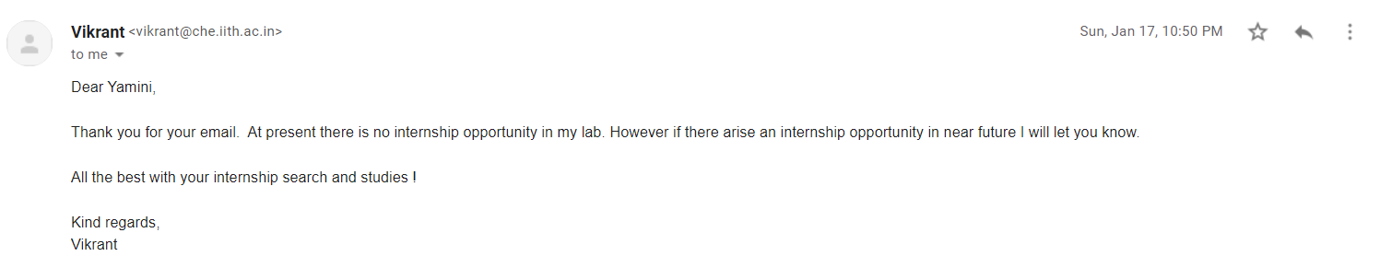
Rejection

Slide 9
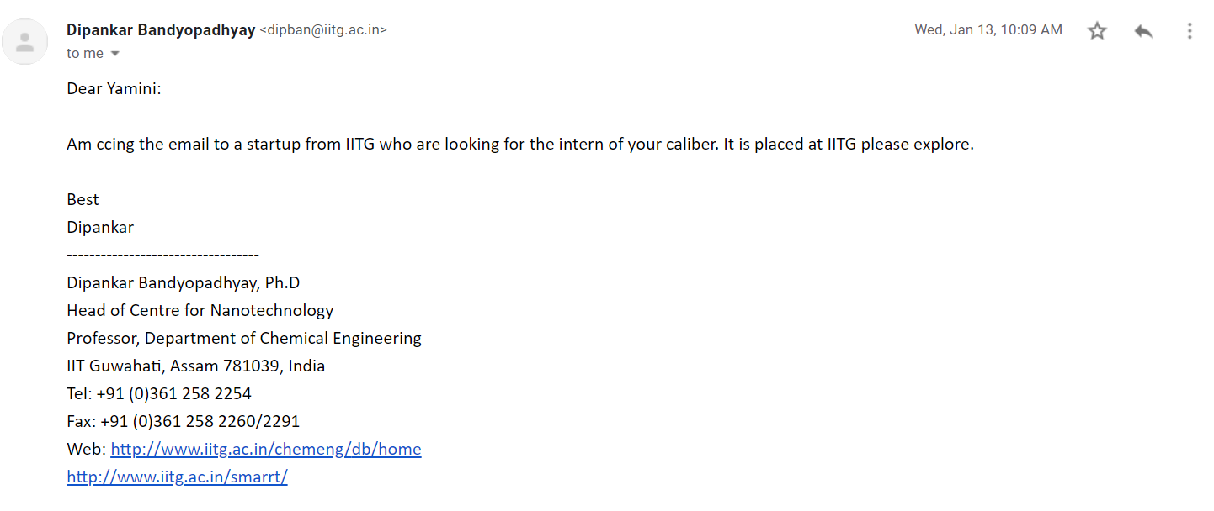
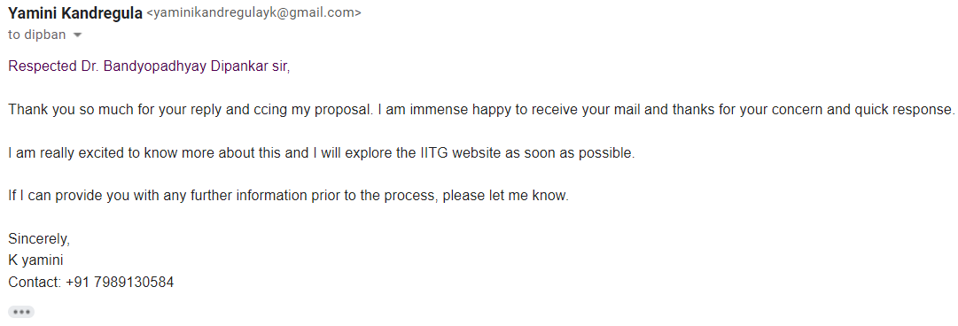
Response

Slide 10
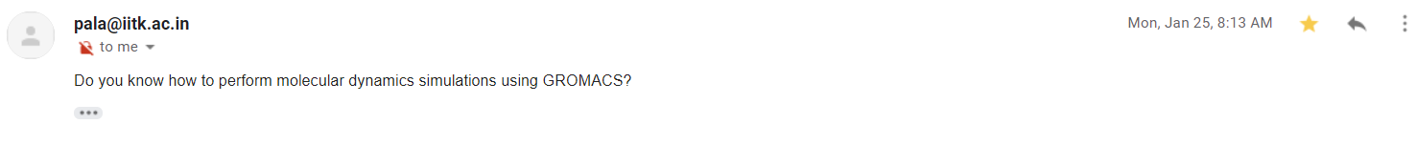
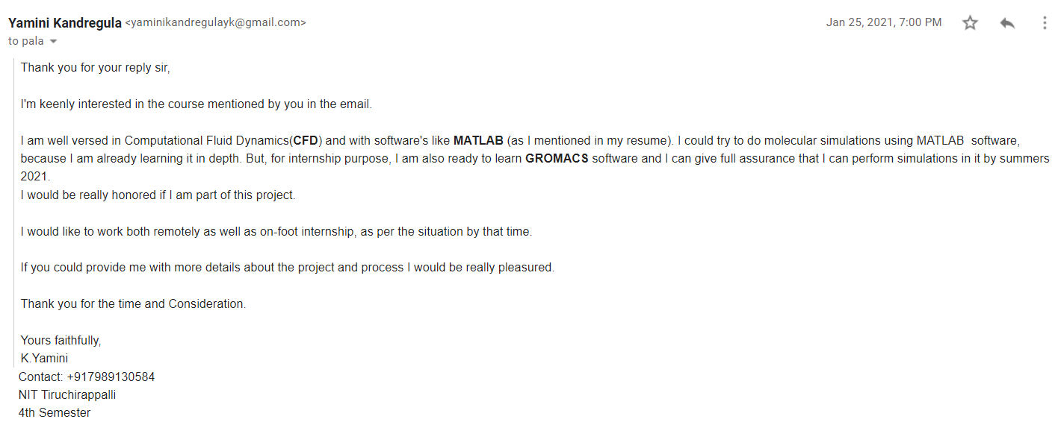
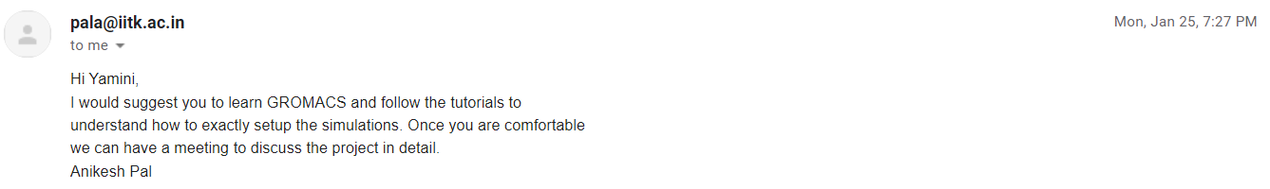
Acceptance

Slide 11
Other Opportunities:
Foreign Interns: Link
After GATE – PSU’s : Link

Slide 12
ALL THE BEST

